Slide 1
DD LFM CEV User Interface User Guide

Slide 2
Table of Contents
Initial Setup
Python (Anaconda) Installation
Installation Type
Python Setup
Opening Spyder
Spyder Working Directory
Run setup.py
Excel Interface

Slide 3
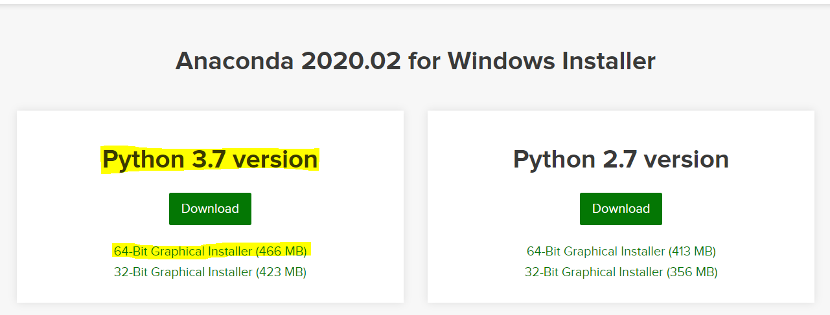
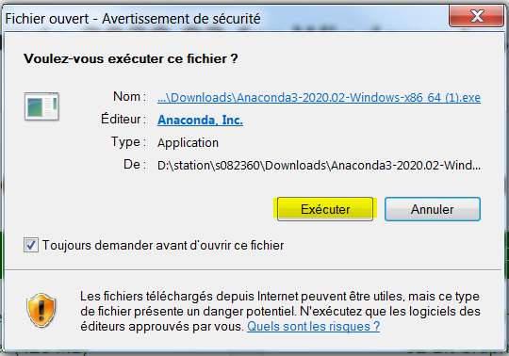
I. Initial Setup
a) Python (Anaconda) Installation
On the Anaconda website, download the latest version of Anaconda:
Execute the installer:
NOTE: Please remove other instances of Anaconda if previously installed. (Except IT installed versions)

Slide 4
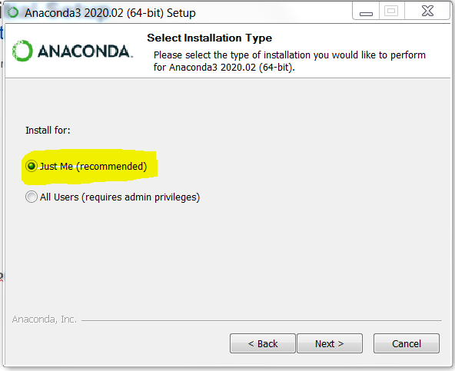
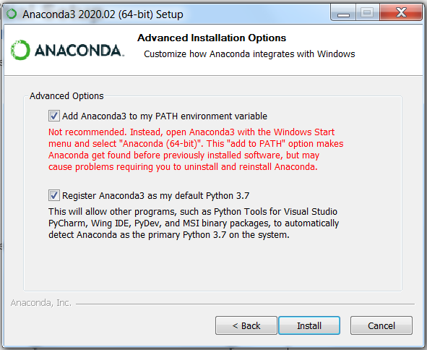
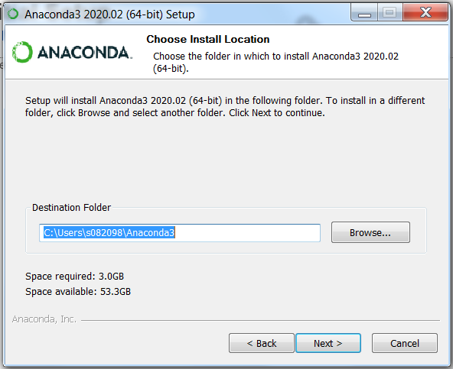
I. Initial Setup
b) Installation Type
Select the Just Me option:
Select the local drive. C:\User\S0
Select both choices on the Advanced Installation Options

Slide 5
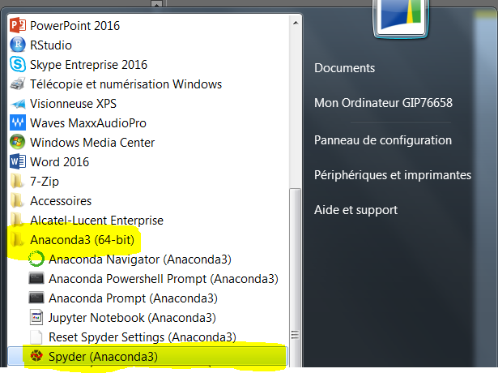
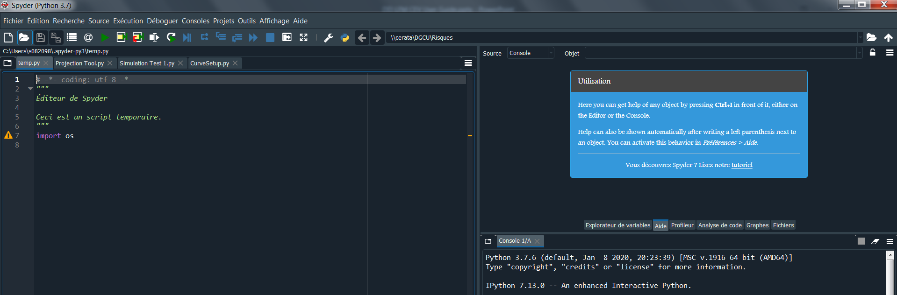
II. Python Setup
a) Opening Spyder
To open Spyder, press the Windows Button , select All Programs and scroll to Anaconda3 (64 –bit)
The platform should ressemble:

Slide 6
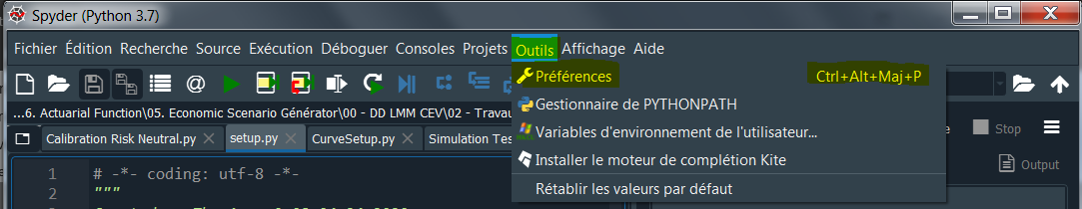
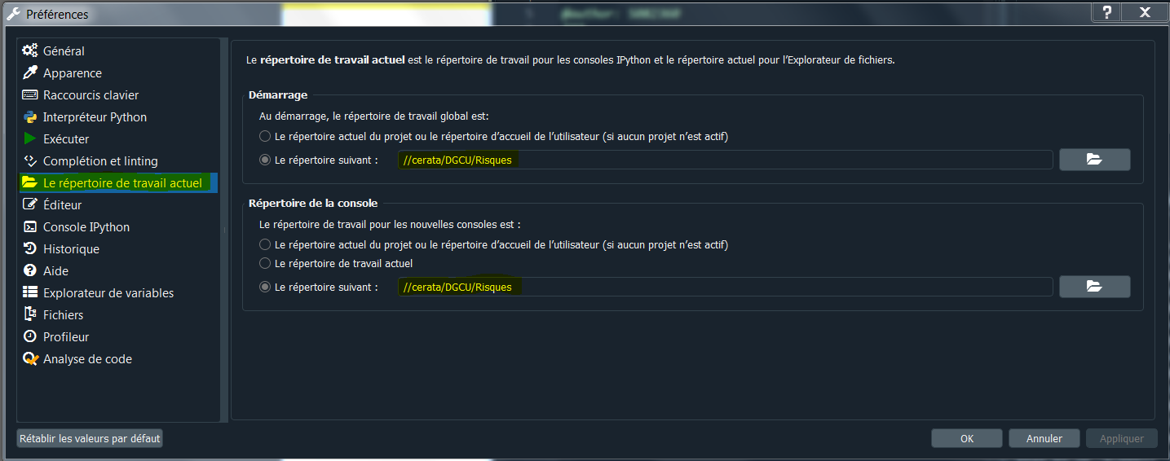
II. Python Setup
b) Spyder Working Directory
To be able to run the worksheet from the server, the working directory on Spyder should be modified
To do this, open Spyder and go to Tools > Preferences:
On the preferences pop up window, select the Working Directory tab and change both locations

